Slide 1

UE Optimization Training
Contributors: Matt Canei, Lead Technical Artist | ILMxLAB

Slide 2
Intro - Performance Principles
Starting Lessons for “Performance-Mindedness”
Learn your show’s FPS/Frame budget.
Learn your department’s “slice of the pie”. Ex: VFX budget vs. Character budget.
Learn the target hardware of what will render/play the show.
Learn how your development hardware differs.
Learn how your discipline affects performance.

Slide 3
Intro - Performance Principles
Principles for Optimized Assets:
Less is more - the smallest amount of triangles, cards, textures, etc. that still fulfills visual targets/direction.
Design detail into the most important areas; drop detail in the least/furthest from camera.
Profile/self-check assets regularly.
Optimize scenes starting with worst offenders/low-hanging fruit.
If test hardware differs from target hardware, measure performance as “% of scene”.

Slide 4
Intro - Performance Principles
Common Real-time Budgets on ILM Shows
Type of Show(s) | Stagecraft | Interactive/Game (Mobile) | Interactive/Game (Console/PC) | VR
FPS | 24FPS | 30FPS | 60FPS | 90FPS
Frame Time | 41.66ms | 33.33ms | 16.66ms | 11.11ms
Tips:
1000 / FPS = Frame Time | 1000 / Frame Time = FPS
Performance is most accurately measured/displayed in milliseconds.
The higher the FPS budget the less milliseconds your frame has to fit in.

Slide 5
Intro - Creating Content Budgets (Pre-Production)
Questions to Answer to Guide Content Budget Creation:
What is our target platform(s)?
  What kind of CPU/GPU/Memory “power” does the platform(s) have? This guides everything. You need to know hardware “breaking points”. If its VR, budgets are usually half of non-VR because it renders uniquely per eye.
What is our lighting schema (Fully dynamic, baked, dynamic sun/baked local, etc.)?
  More dynamic lights = more shadow geo = lower tri counts.
What is our Frame Rate Target? 30FPS(33.33ms), 60FPS (16.66ms), 90FPS (11.11ms).
  This decision establishes the quality ceiling. Sometimes you can do 33.3ms GPU and 16.6ms game/input. In general, high quality projects should be 30FPS, fast/twitchy gameplay projects should be 60. VR HAS to be 90 b/c motion sickness.
What visual features need researched/want to be used?
  Rendering features can have a high base cost just to exist (ex. Lumen in UE5).
What are the visual pillars?
  This helps guide where to allocate more budget when subdividing between departments.
What anti-aliasing/resolution management systems will we use?
  Default UE4/5 Temporal AA, DLSS, AMD FSR, etc. Can we use Dynamic Res? Eye-tracking-based resolution, etc. This helps guide base performance and base image clarity of silhouettes.
How much VRAM/memory do we have?
  This determines max texture sizes, has some impact on mesh memory.

Slide 6
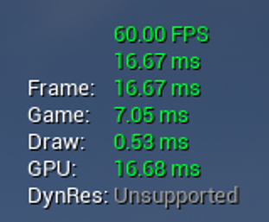
Intro - Performance Metrics
Unreal processes real-time scenes in threads:
Frame: Total time to calculate the frame.
Game: C++/Blueprint CPU operations.
Draw: Rendering CPU operations (what to render).
GPU: Rendering GPU operations (final pixels - after CPU render operations).
RHI: Rendering Hardware Interface (some platforms use this) - How Unreal C++ communicates with Render APIs (DirectX, OpenGL, etc.)
Tip: Press ~ to open console in UE editor (or running the game)
Stat unit - Displays the thread timings above.
Stat fps - Displays FPS.

Slide 7
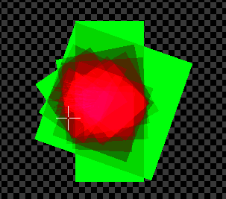
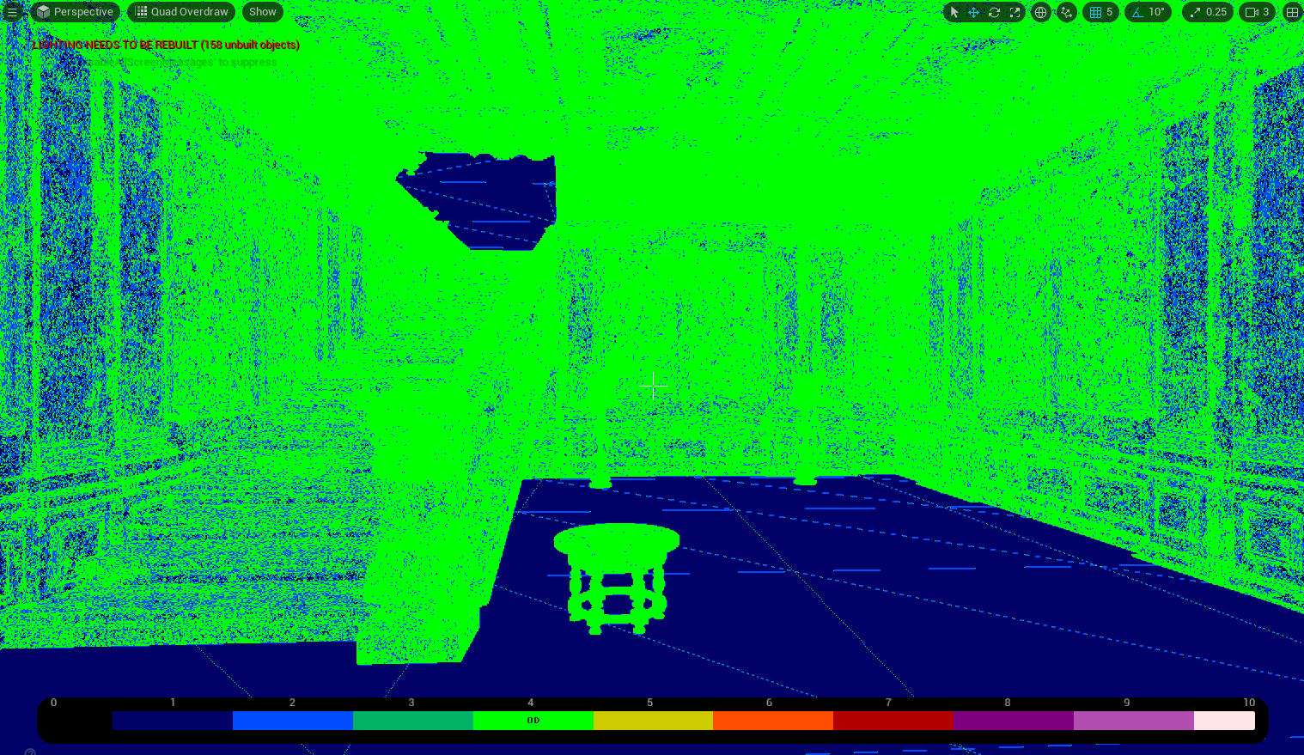
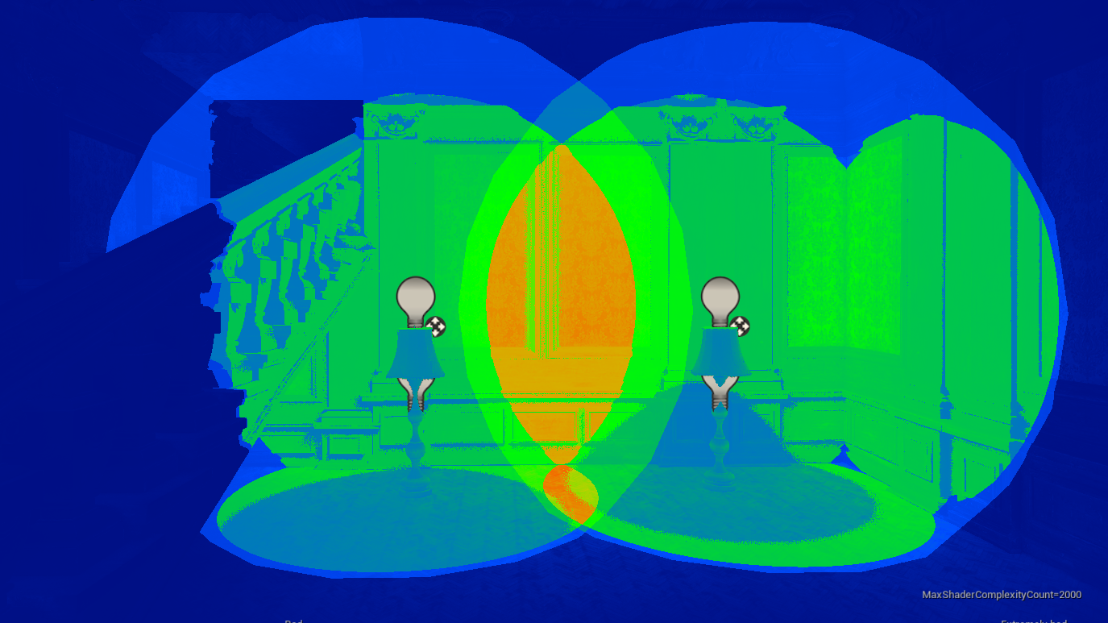

Intro - Performance Principles
Common Performance Terms
Term | Overdraw | Sub-pixel Geometry / Quad Overdraw | Shader Complexity (Instruction Count) | Light Complexity
Practical Definition | Rendering of the same pixel multiple times, due to overlapping non-opaque sprites or geometry. | Rendering of small polygons in blocks of 4 pixels (2x2). Also: Many vertices rendering within individual pixels. | The number of shader instructions calculated in each pixel & vertex. | The number of overlapping light radii/calculations per pixel.
Impact | Render slow downs due to redundant rendering of the same pixel. Each layer of overlap = worse performance. | Similar to overdraw, the renderer has to process many vertex operations for small pixel spaces. | The more shader instructions per-pixel & per-vertex, the more calculation time per-pixel & per-vertex. | Overlapping dynamic light radii cause redundant draw calls of Per-Object and Pre-Shadows for all affected objects.
Example

Slide 8
Intro - Performance Principles
Common Departmental Performance Bottlenecks
Term | VFX | Environment Art | Character / CrDev | Lighting
Common Bottlenecks | Overdraw Draw Calls Shader Complexity | Quad overdraw/sub-pixel geo Overdraw (foliage) Draw Calls | Quad overdraw Shader complexity Bone count | Lighting Complexity Tri Count (Shadow Tris) Overall GPU
Quick Fixes | Reduce lifetimes of sprites Keep card geo more closely conformed to sprite/alpha. Reduce spawn rates based on camera distance/distance from camera. Keep materials simple. | Always have LOD’s for objects that automatically or specifically swap to lower detail at distance. Use the least amount of geo possible to hit the look. Not all textures have to be the same size/largest size. | Always have LOD’s for characters to drop geo at distance. Create simpler materials for lower LODs. If texture changes can happen in the texture do it there, not in the shader. | Avoid light radii overlapping, this causes multiplicative/reundant light/shadow rendering. Lights drive up the cost of all content types. Use the minimum amounts of lights possible to achieve look.

Slide 9
Intro - Performance Profiling
Type of Perf Testing and When to Use
Project Phase | Early/Pre-Production | Deep Development | Late Dev | Post Content-Lock
Build Configuration/General Test Config | Development Build No FPS cap, no Vsync, No Dynamic Res | Development Build No FPS cap, no vsync, no dynamic res | Development Build (and Test if time permits) No FPS cap, no vsync, no dynamic res | Test Build No FPS cap, no Vsync, Dynamic res on (if project uses)
Test Commands/Notes | Csvprofile start/stop OR startfpschart / stopfpschart Usually you want t.maxfps 0; r.vsync 0; r.dynamicres.operationmode 0; r.gpucsvstatsenabled 1 | Csvprofile start/stop OR startfpschart / stopfpschart Usually you want t.maxfps 0; r.vsync 0; r.dynamicres.operationmode 0; r.gpucsvstatsenabled 1 | Csvprofile start/stop OR startfpschart / stopfpschart Usually you want t.maxfps 0; r.vsync 0; r.dynamicres.operationmode 0; r.gpucsvstatsenabled 1 | Csvprofile start/stop OR startfpschart / stopfpschart Usually you want t.maxfps 0; r.vsync 0; r.dynamicres.operationmode 2; r.gpucsvstatsenabled 1

